Slide 1



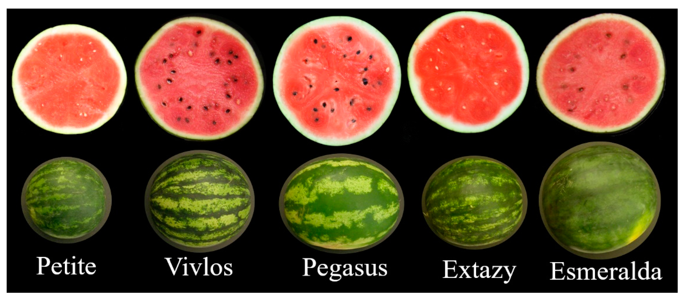
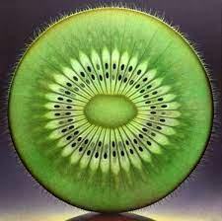
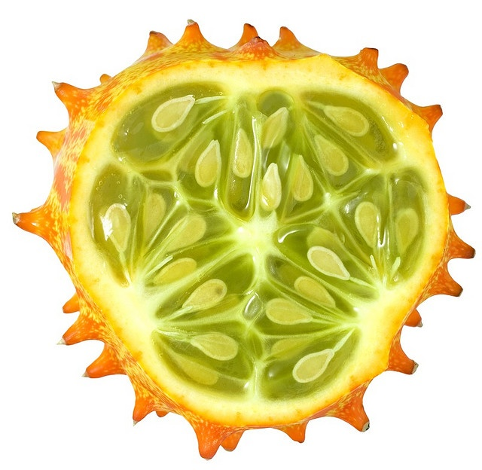
Symmetry
Business Intelligence

Slide 2
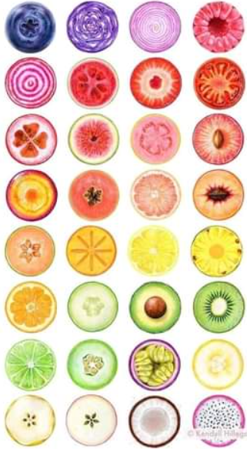
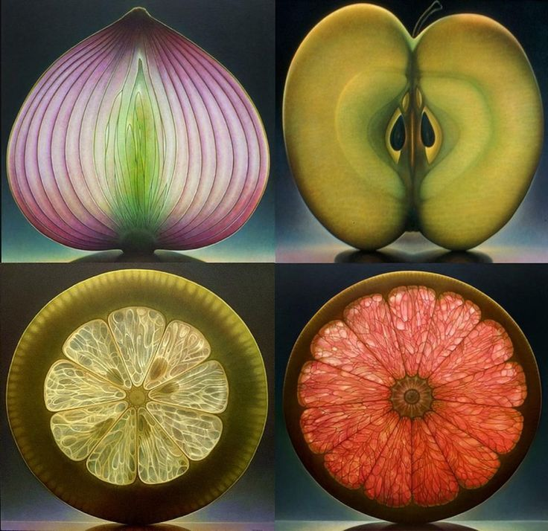


Which topic did you research and how does it work?
Symmetry in everyday language refers to a sense of harmonious and beautiful proportion and balance.

Slide 3





In mathematics, "symmetry" has a more precise definition, and is usually used to refer to an object that is invariant under some…

Slide 4

In mathematics, "symmetry" has a more precise definition, and is usually used to refer to an object that is invariant under some…
… transformations; including translation, reflection, rotation or scaling

Slide 5
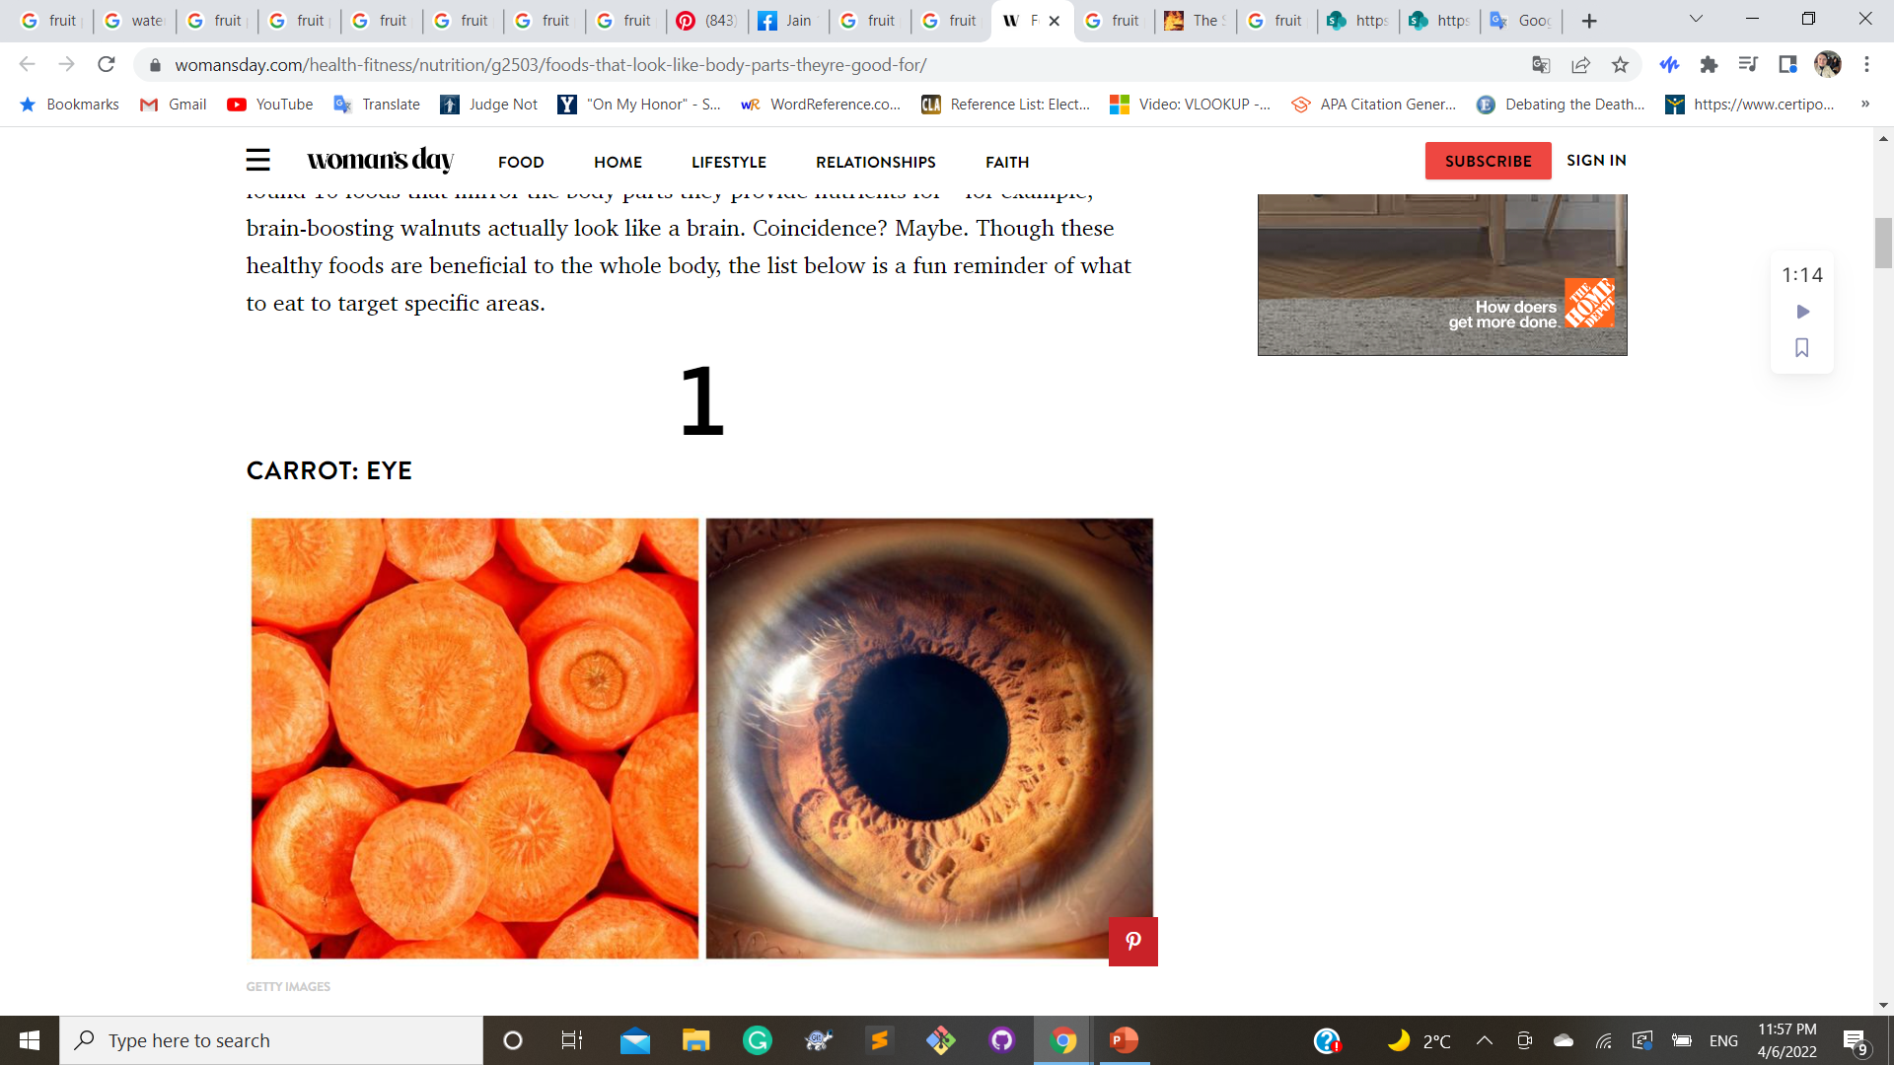

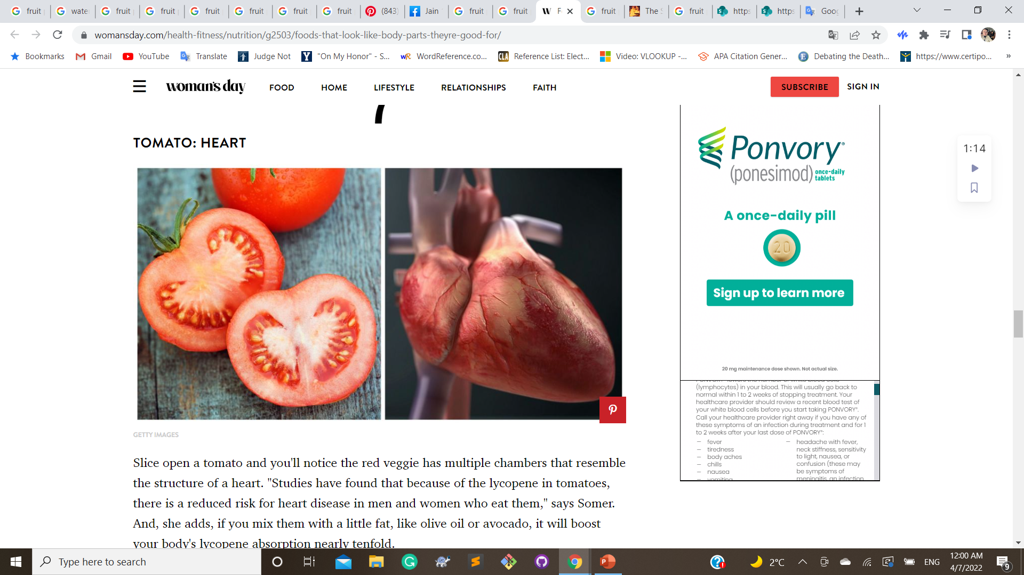
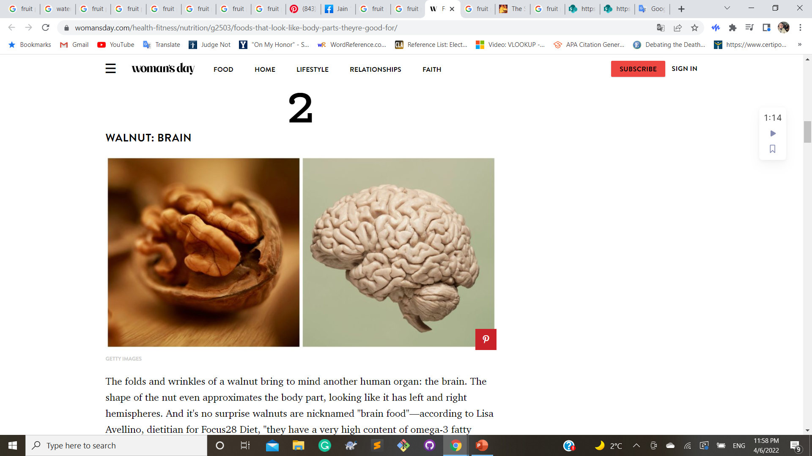
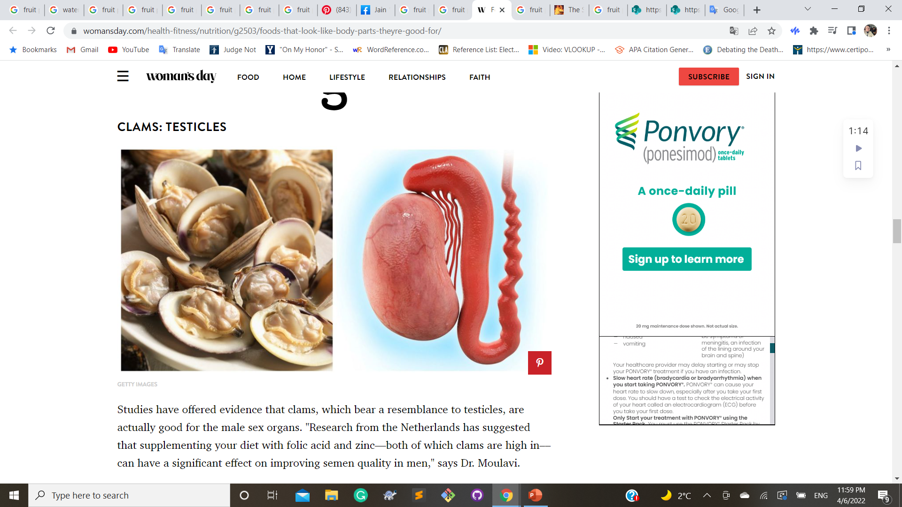

Patterns are in:
Plant
Fruit
Body

Slide 6

How can this natural pattern be used in the context of data analysis?
Data
Analysis

